Slide 1

React JS

Slide 2
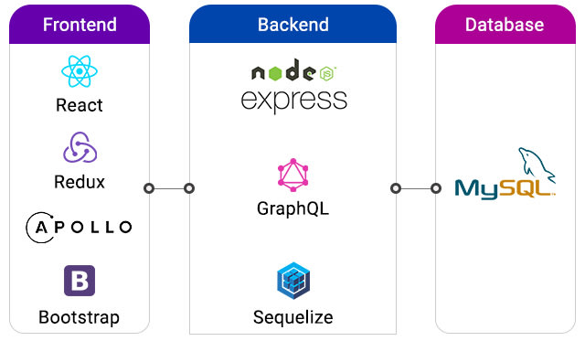

Slide 3
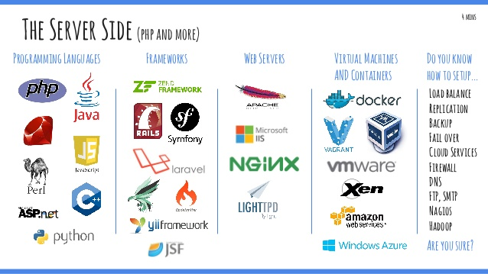

Slide 4
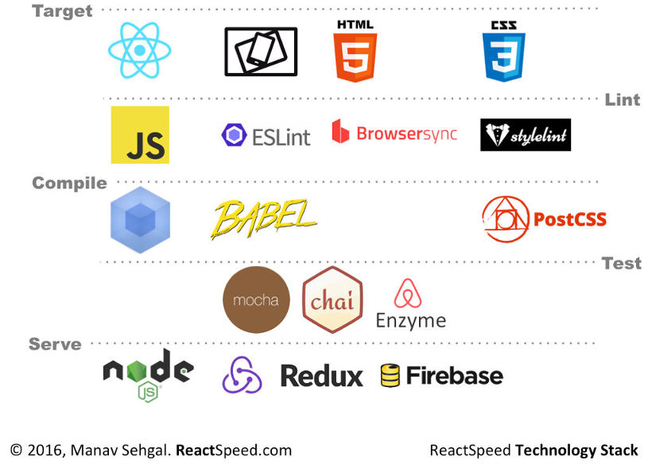

Slide 5
What Is reactJS?
ReactJS is an open-source, front end library component that is responsible only for the views of the application. React JS is managed by Facebook.
ReactJS uses a virtual DOM to populate the display data in the HTML DOM. Virtual DOM works fast to change individual DOM elements
React applications consist of many components, one of which is responsible for reusable HTML output

Slide 6
React JS can design simple views for each level in the application, so that it can be used to create and develop web-based application development. Its popularity can be measured by applications that use it such as Facebook, WhatsApp, Netflix, Instagram, Airbnb, American Express, Dropbox, Ebay, and hundreds of web-based application development service providers taking advantage of React JS capabilities.

Slide 7
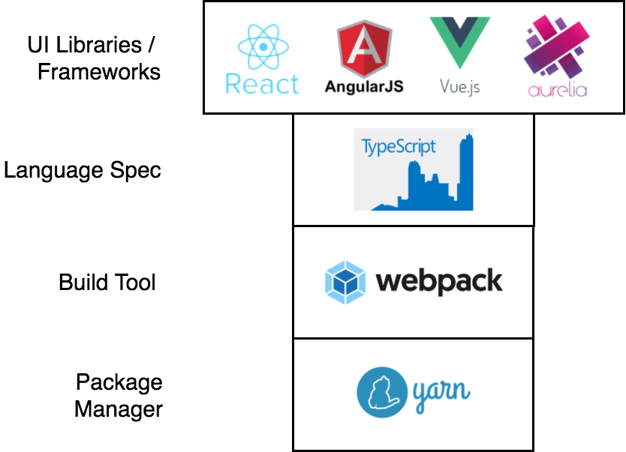

Slide 8
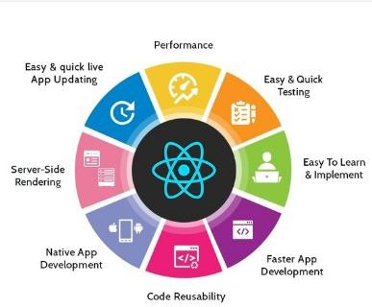
Why Reactjs?

Slide 9
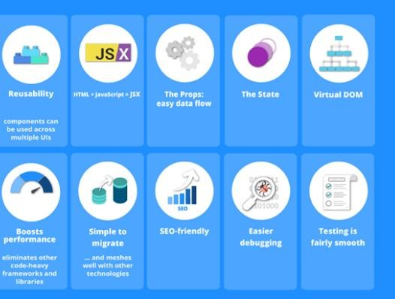
Why Reactjs so popular?

Slide 10
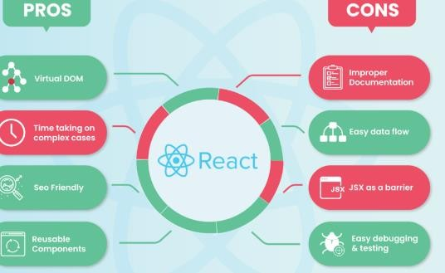
Pros and Cons of ReactJS

Slide 11
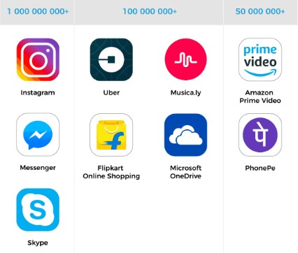
Where ReactJs Using?

Slide 12
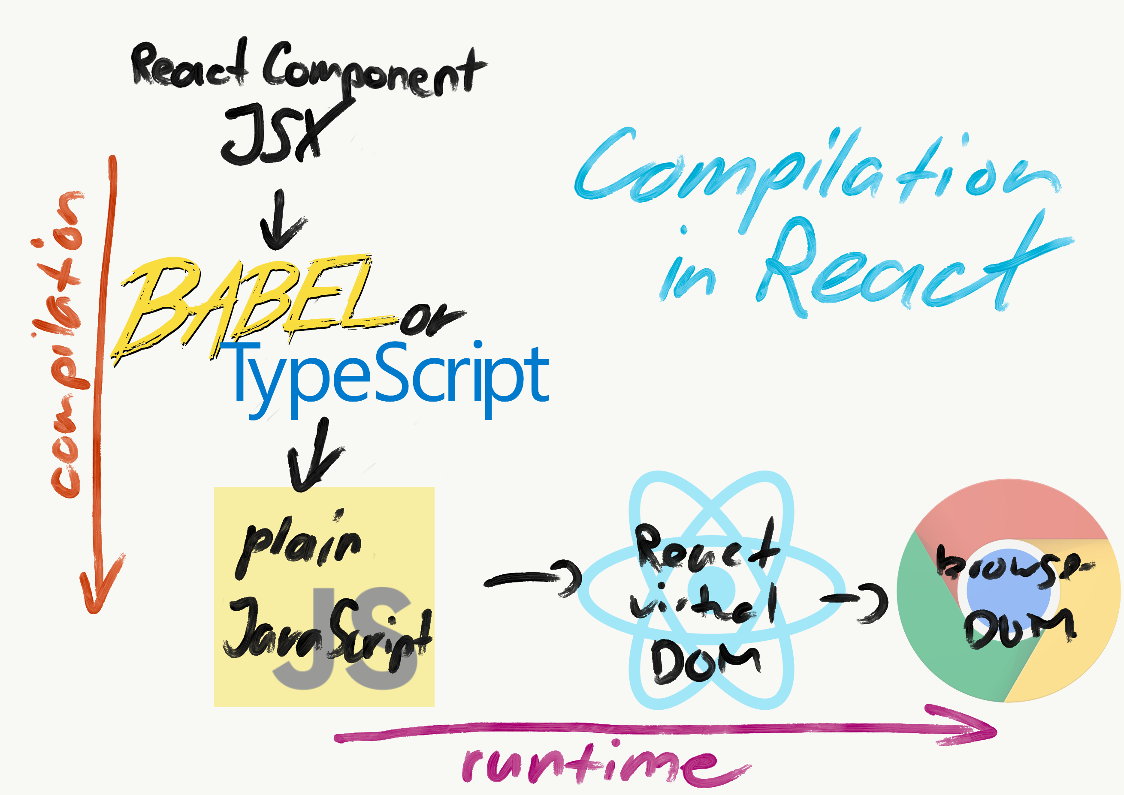

Slide 13
There are also features that React JS excels in, namely:
Declarative
Declarative views can make code easier to predict and easier to debug.
2. Component - Based
Can create Encapsulated Components that can manage each stage, then can create complex UIs based on that capability.
3. Learn Once,
Write Anywhere Developers can develop new features using React without changing the previous code, React can also work with Node JS and mobile apps using React Native.

Slide 14
The advantages of React JS are:
React JS is easy to learn and master
React JS framework statement full featured but it is an open source JavaScript GUI library which concentrates on one specific thing and aims to complete tasks efficiently
2. Support component reuse (component here = code)
React JS allows you to reuse components that have been developed into other applications that use the same functionality.
3. Easy to write components React JS makes use of JSX,
which is an optional syntax extension for JavaScript. Writing components is simpler with JSX because it supports you to combine HTML with JavaScript.
4.React Native for Mobile App Development
React JS can be called a “one-time-write-anywhere” library, because in both web and mobile application development, React follows the same design pattern, facilitating the transition process.

Slide 15
Webpack
Webpack is a bundle of open source JavaScript modules. Its main purpose is to combine JavaScript files so that they can be used in the browser, but it is also capable of converting, merging, or packaging almost any resource or asset.

Slide 16
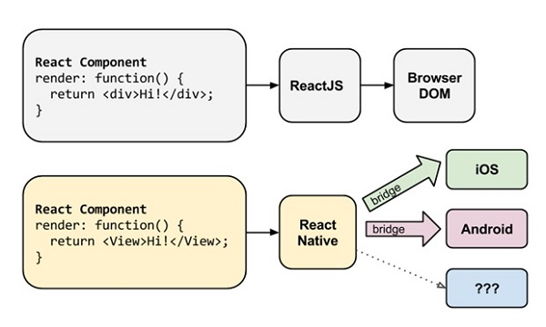

Slide 17

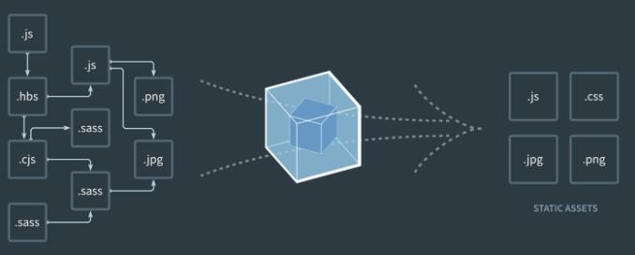
When Webpack processes your application, it creates a dependency graph that maps the modules your project needs and generates one or more bundles.
Bundles are different groupings of linked code that have been compiled and modified for the browser.

Slide 18
Webpack takes some assets (images, fonts, styles) and converts them into dependencies for the application
Webpack consists of 5 principles
Entry
Output
Loaders
Plugins
Mode
Entry is the entry point for the application.

Slide 19
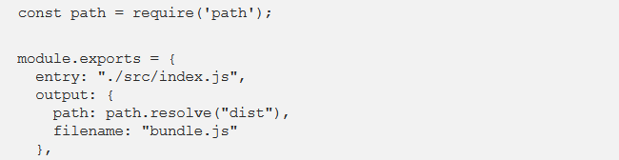
The simplest Webpack configuration is generally in the form of an Object and consists of 3 parts, namely entry, output, and module.
1. Entry: is the main file and the first to be executed in our application. In the code below, the main file of our application is index.js, and is located in the src folder relative to the webpack.config.js file so it uses a. (point).
2. output: set the result of the bundle when finished processing by Webpack. The one called bundle.js and is located in the dist folder.
3.module: the module part functions as an additional process when the bundling process is running

Slide 20
Webpack, look for all files that end in js and jsx but don't need to find the files in the node_modules folder. Once found, I want the babel-loader plugin to be used to handle these files. That is all.

Slide 21
Definition of Babel
Babel (Javascript Compiler, used to translate certain code into code that is recognized by the browser.
For example: ES6, ES7 is translated into ES5 so that it can run on older versions of browsers, then JSX becomes a regular javascript Object).

Slide 22
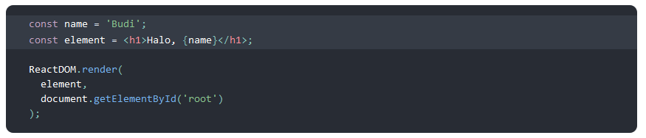
What is JSX?
an extension syntax for JavaScript.
JSX may prompt you with a template language
JSX will generate React "elements"
Writing JSX in curly braces

Slide 23
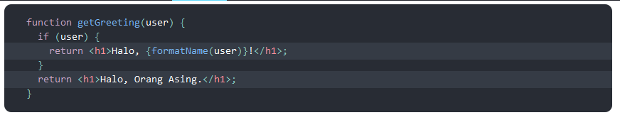
Defining Attributes with JSX
Once compiled, JSX Expressions will become regular JavaScript function calls and become JavaScript objects.

Slide 24
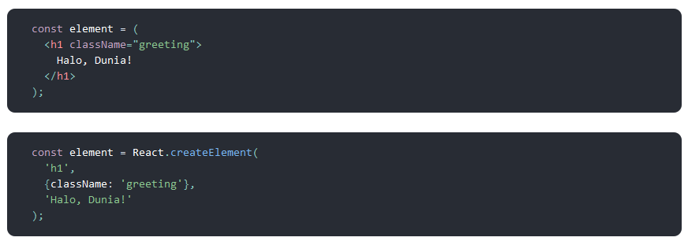
JSX Represents Objects
Objects like this are called "React elements". React reads these objects and uses them to build the DOM and keep it current.

Slide 25
Result
The components in the react-app installation are webpack, JSX, and Babel
React is a JavaScript library developed by Facebook to easily manage user interfaces for web applications.
JSX is an XML-like syntax extension for ECMAScript without any specific semantic definitions. NOT designed to be implemented by engines or browsers

